Slide 1
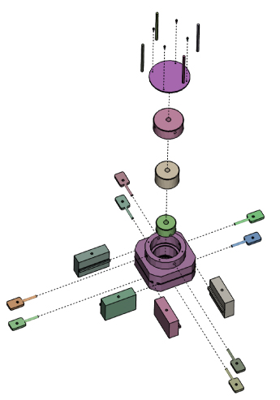
Assembling the Milky Way
David Spergel

Slide 2
What has changed?
Context:
  Standard cosmological model
  No galaxy is an island… (John Dunne vs. Immanuel Kant)
Tools:
  Statistical galactic astronomy
    100s of stars -> 100,000s -> 1e9 (GAIA +LSST)
  Precision metallicities
  Numerical simulations reaching relevant scales: possible to simulate galaxy in cosmological context
    Elliptical are “easy”, disk galaxies are hard t_{form} >> t_{dyn}
    Importance of orbit-based tools for secular effects (e.g., Sellwood-Binney)

Slide 3
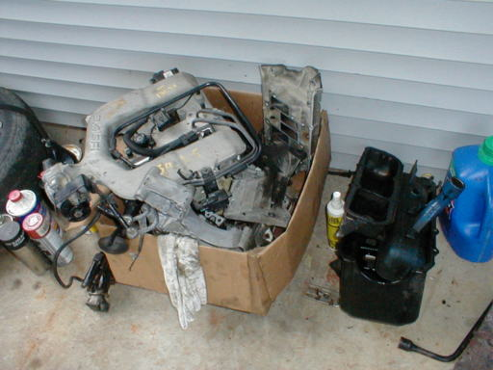
Milky Way: Assembly from Parts
Can we see the pieces?
  Do the lumps come in as stars? (halo?)
  Do the lumps come in as gas? (disk?)
    Hot? Cold?
  How do the lumps effect previously existing structure?
Unused piece problem
  total mass: 1.4e12 (Smith et al.; RAVE)
      1e12 Xue et al. (SDSS) [4e11 within 60 kpc]
  Expected baryon mass: 2.4e11
  Observed baryons: 4-8e10
    where are the unused 90%!
Angular momentum problem
Do we live in a typical Galaxy?

Slide 4
Thin Disk
Do the properties of the galactic disk reflect initial conditions?
How important is on-going accretion? Role of cold streams? HVCs? Accretion from hot halo??
Is there a dark disk?
Role of winds in chemistry?
Age-metallicity relationship?
  Can we believe the ages?
Role of churning (Sellwood/Binney)
Deviations from axisymmetry in dynamics and abundances
  Open clusters as hierarchical structure formation in disks
  Bar effects from OLR (Dehnen 2000)
  Spiral structure (Minchev & Quillen 2005)
  Constraints from fluctuations in metallicity for young stars
  Constraints on mixing

Slide 5
Thick Disk
What is its origin?
  Seems to easy: mergers should form a thick disk and Sellwood/Binney should do it
Two thick disks? (Binney)
Thick disk (10%)- more in smaller galaxies (Dalcanton, etc.)
Kinematically distinct? Merger event at 10 Gyr? RAVE evidence for distinct kinematics
Distinct in α/Fe
Disk evolutionp: many processes
  Infall, fountain, radial inflow, disk heating, minor merger, radial mixing. Which ones matter?

Slide 6
Bar and Bulge
When did the bulge form?
When did the bar form?
    Stars are old and there are significant metallicity gradients
    Is it long-lived?
When did the metal rich stars form?
Can we reconcile a bar formation and reformation scenario with the observations?
Bar/Halo Interactions

Slide 7
Stellar Halo + Dwarf Spheroidals
How big is the halo? (stellar?) (dark matter?)
Was the halo made of dwarf spheroidals? How different from current dSph?
How many?
  More and more streams in outer halo(SEGUE, Grillmair …)
  Radial velocity substructure: structure in the nearby halo (10 < r <17.5 kpc) (Schlaufman et al. 2009)
  Bell et al. 2008 match to Bullock & Johnson 2005
  LCDM seems to have survived its substructure crisis
Low metallicity stars from many dSph; High metallicity stars from a handful of early dSph
All prototypes are exceptional: Sgr
  large gradient in tidal tail of Sgr (Chou et al. 2007). Significant difference between tail metallicities and Sgr core.
    Sgr chemical properties (s/Fe; La/Fe, Y/Fe) shows different SFR than other dwarfs. Universal enrichment history – difference due to rates (rather than IMF)

Slide 8
Chemical Evolution
Not even globular clusters are simple:
  Dual sequences (NGC 1851, ..); second parameter problem
    Intrinsic evolution; external pollution; self-pollution; primordial variations?
Halo metallicity distribution
  Regular shape – well fit by outflow models with reduced yield (1/10th local effective yield)
  Very smooth – is this compatible with hierarchical merging?
  Building block are unaffected by SNIa ejecta (formed in less than 1 Gyr or the SNIa ejecta escaped)
Dwarf and Milky Way halo have a G dwarf problem (outflow or pre-enrichment or early infall)
Mixing within proto-open cluster? Mixing within proto-dwarf spheroidal? Mixing rate within galaxy? Constraints on galactic fountain

Slide 9
Nucleosynthesis
Elements and isotopes
  Solar system abundances fit reasonably well by models but intriguing anamolies
Abundance trends
  Surprises:
    N (mixing)
    Ti (behaves like alpha peak)
    Co/Fe, Zn/Fe and Cr/Fe are not fit by models
    Hypernovae as a source of Zn?
Individuals matter: intriguing fluctuations
  Eu/Fe shows huge scatter at Fe/H < -2
    Product of strong r process
  r process doesn’t mix well
Future: Nucleosynthesis with 3D models
  With distributed ignition points for SNIa
  Neutrino transport

Slide 10
First Stars
They are in the bulge but “not of the bulge” (JT)
  Wide dispersion of Fe/H at any age
  Can already constrain models with invariant IMF
  Target for APOGEE
  Pair-instability SN chemical signatures
    no Zn and no Co, no r-process
    Doesn’t look like low Z stars
Carbon-rich stars at low metallicity? Binaries?
Spin stars?

Slide 11
Milky Way as a Spiral Galaxy
Is the Milky Way special?
My education on spectral synthesis:
  Colors are not useful: degenerate to change in age and composition
  5 Gyr [Fe/H]=-0.4 and 15 Gyr [Fe/H]=-0.7 are almost identical (Hβ/ MgII can separate these two).
  SSP ages= birthrate of stars in the last 0.1-2 Gyr
  Contamination by burst populations
  Importance of calibration of stellar population models (Schiavon…
Sauron observations of Sa
  Younger, more metal-poor and less a-enriched than E/S0s. Larger range in ages.
  Young stars disk polution or peusdo-bulges
What does the MW look like in integrated light? MW is old for an Sc galaxy. Are we missing the inner (and younger part of the Galaxy)
What is the age-metallicity gradient in our bulge and inner disk?

Slide 12
Surveys
Revolution in the size and quality of data
  SEGUE and RAVE
  APOGEE, HERMES, GAIA, LSST,…
    LSST: 1.0 mas for parallax and 0.2 mas/year for proper motions.
Synthesis of chemical tagging with dynamics
  How many tags? (many HR1614s)
  How do we construct global models?
  How do we characterize fluctuations?
    Streams
    Fluctuations in chemical properties with orbits
In ten years, will we have a coherent formation history for our disk, bulge, and halo?
  What are the key questions? What do we need to do to address them? Theoretical tools?

