Slide 1
Stellarator in a Box: Understanding ITG turbulence in stellarator geometries
G. G. Plunk, IPP Greifswald
Collaborators: T. Bird, J. Connor, P. Helander, P. Xanthopoulos, (Yuri Turkin)

Slide 2
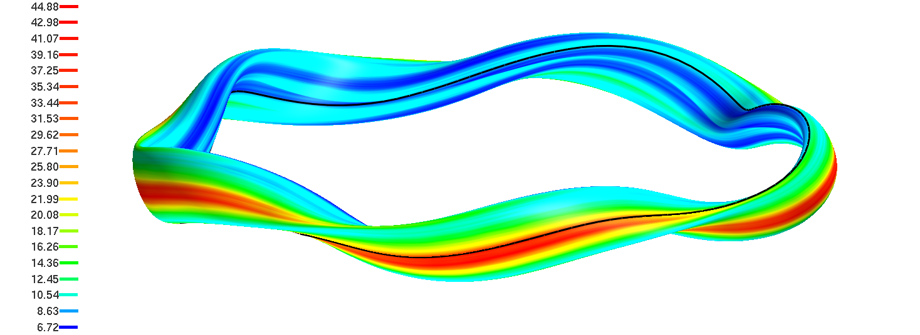
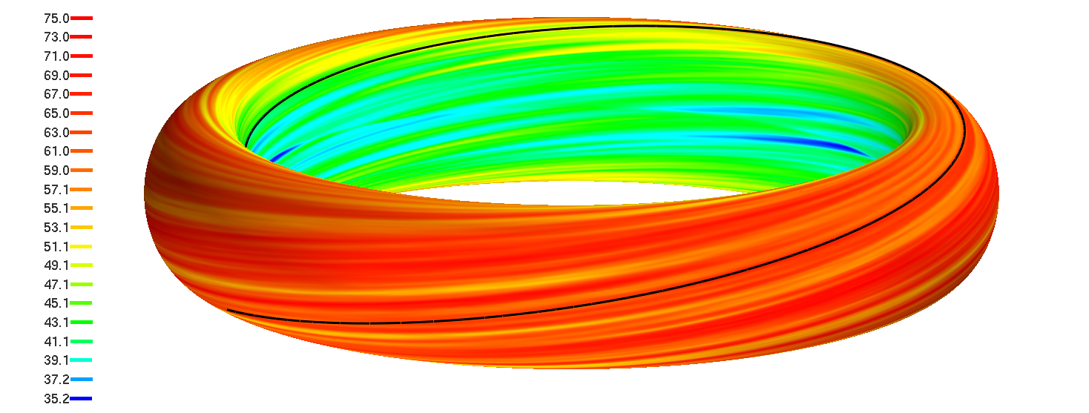
W7X vs. a Tokamak

Slide 3
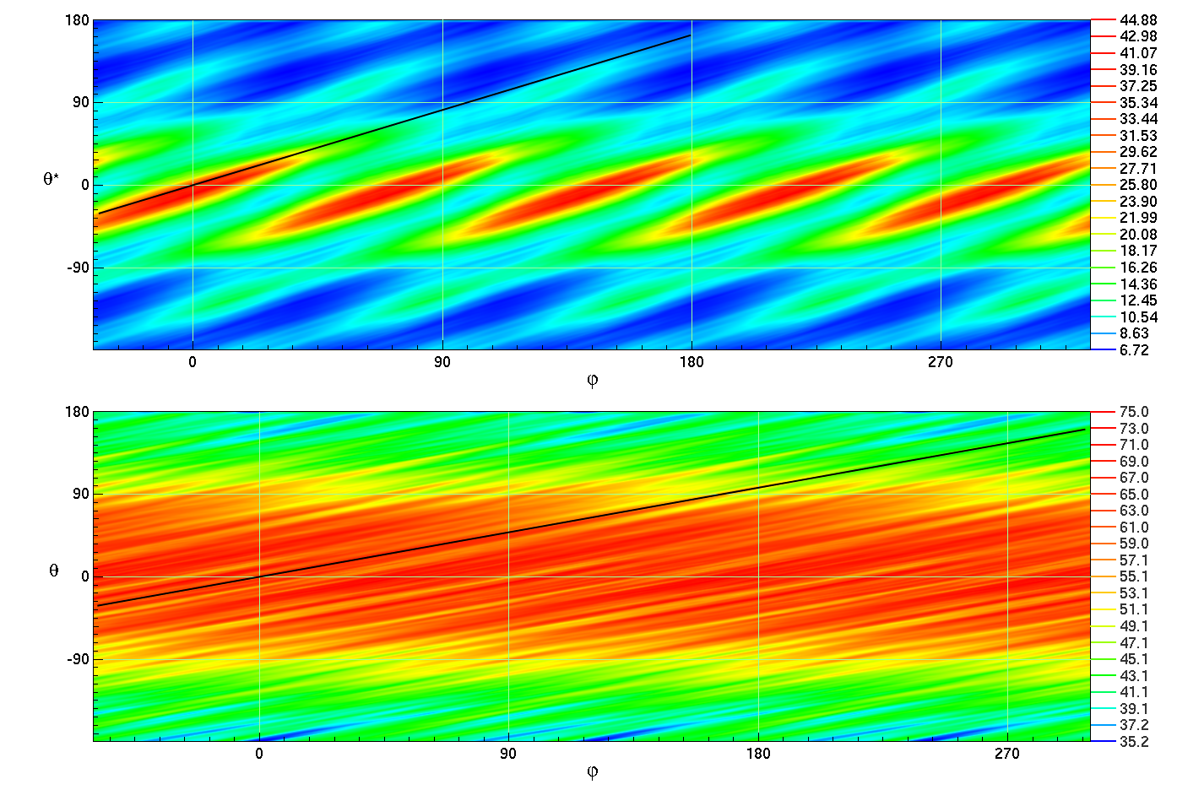
W7X vs. a Tokamak (r.m.s. ϕ)

Slide 4
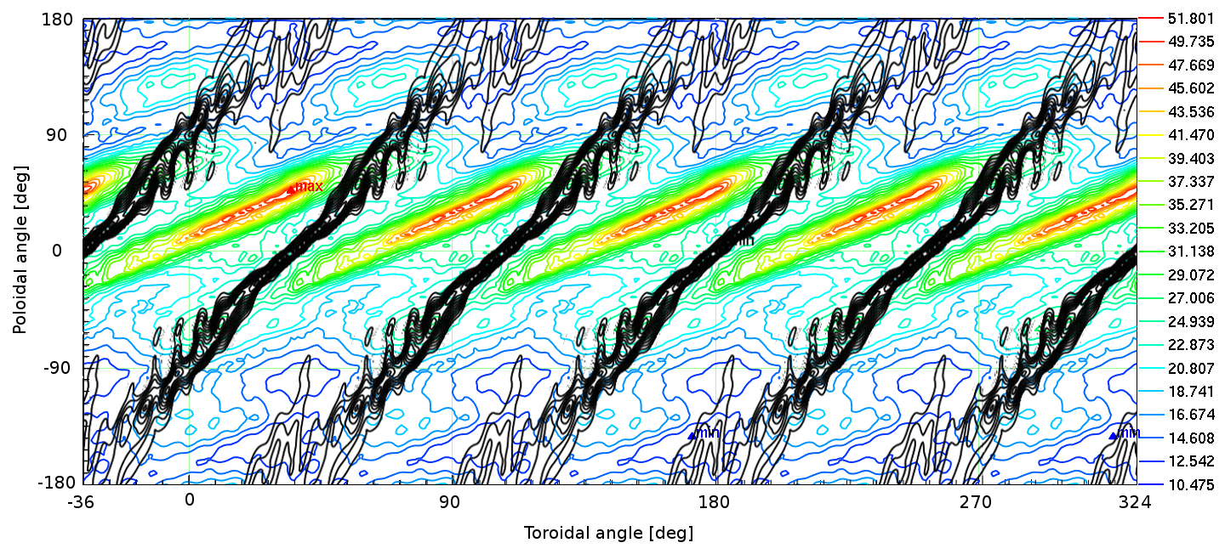
Turbulence in stellarators is localized along the magnetic field (W7X)
Black contours show local magnetic shear
Credit: P. Xanthopoulos; see [P Helander et al 2012 Plasma Phys. Control. Fusion 54 124009]

Slide 5
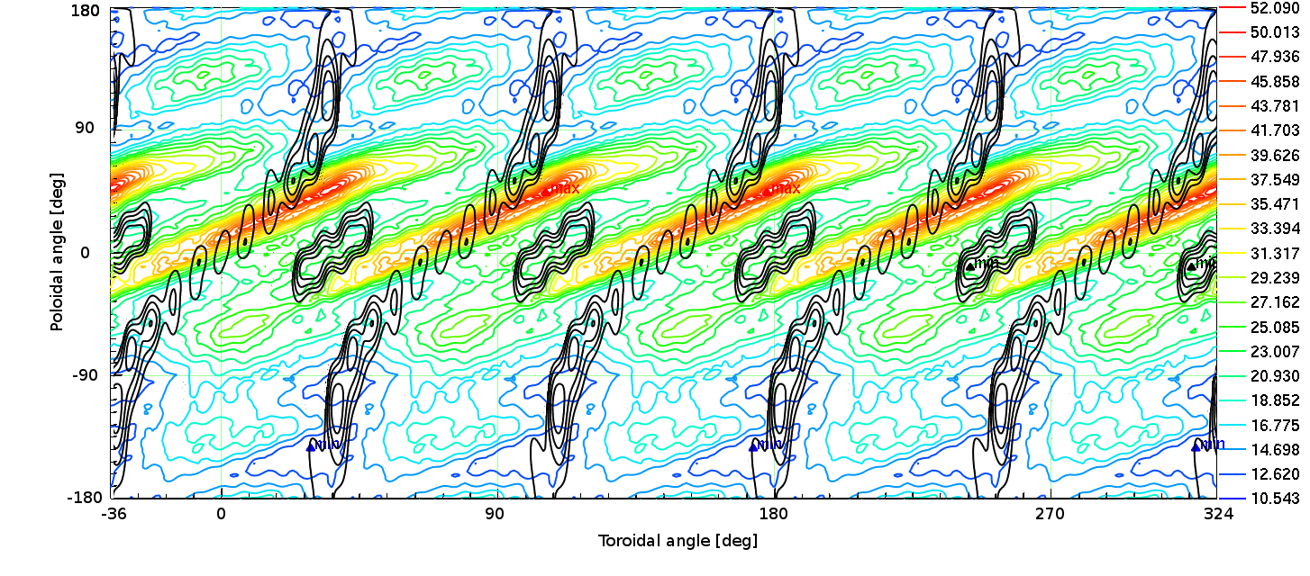
Turbulence in stellarators is localized along the magnetic field (W7X)
Black contours show normal curvature
Credit: P. Xanthopoulos; see [P Helander et al 2012 Plasma Phys. Control. Fusion 54 124009]

Slide 6
Overview
Localization of Turbulence
Part I: Local Magnetic Shear*
Model integral equation
Numerical experiments with Gene
Part II: “Bad curvature” wells
“Boxing” or “Ballooning?”
SA-W7X: looks like a tokamak, feels like W7X
Part III: Nonlinear theory (TBC)
*[R. E. Waltz and A. H. Boozer, Phys. Fluids B 5, 2201 (1993)]

Slide 7
Overture: The “Local” ITG Mode
Wave solution
Dispersion relation:
Branch | Identifying Features | Stabilization Criterion
Toroidal ITG | parallel wavenumber is stabilizing
Slab ITG | most unstable mode has finite parallel wavenumber
[Kadomtsev & Pogutse, Rev. Plasma Phys., Vol. 5 (1970)]

Slide 8
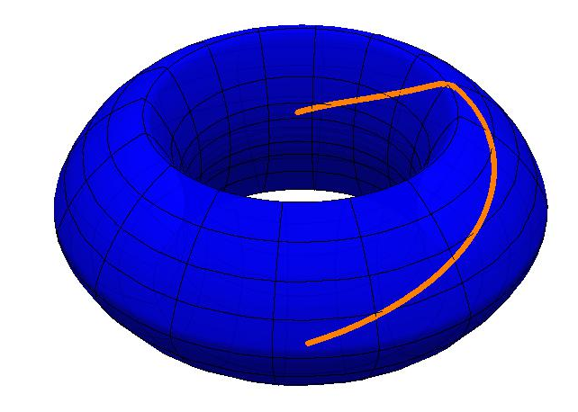
Stabilizing Effect of Parallel “Localization” on Slab Mode
Tokamak estimate:

Slide 9
Part I: Local Magnetic Shear.
W7X

Slide 10
Theoretical Model* * [J W Connor et al, 1980 Plasma Phys. 22 757]
Eikonal representation for non-adiabatic part of δf1:
“Ballooning”
Linear GK Equation:
[Source: http:GYRO]
Solution:

Slide 11
Theoretical Model* * [J W Connor et al, 1980 Plasma Phys. 22 757]
Eikonal representation for non-adiabatic part of δf1:
Linear GK Equation:
Solution:
Where:

Slide 12
Theory…
Outgoing boundary conditions
Solution becomes:
Approximation:
Substitute solution into quasineutrality equation

Slide 13
Integral Equation

Slide 14
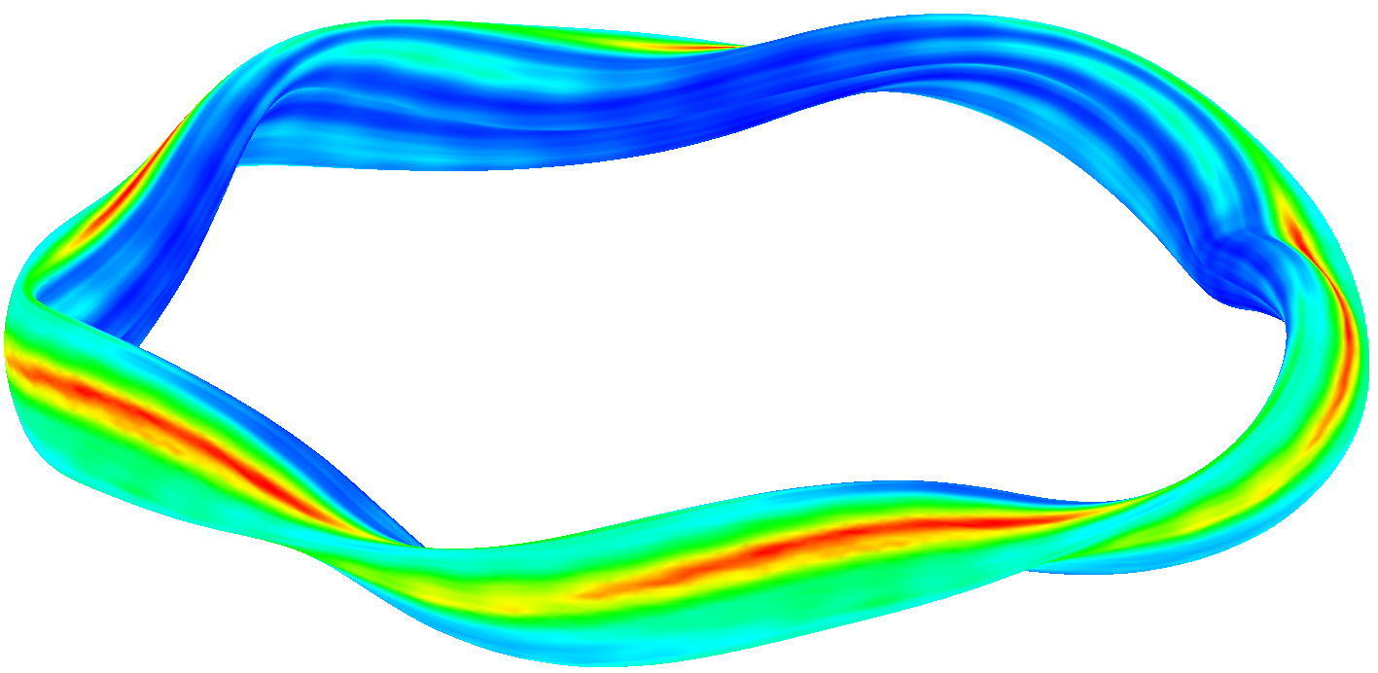
W7-X Parameters
Aspect Ratio
Also let
So

Slide 15
Growth rate curves (pure slab)
Slab mode: half wavelength fits in the box

Slide 16
Growth rate curves (pure slab)

Slide 17
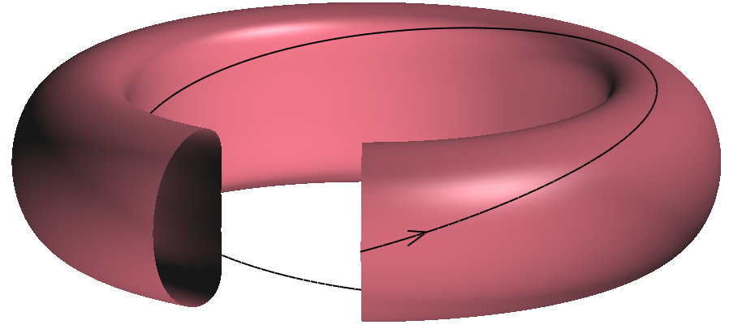
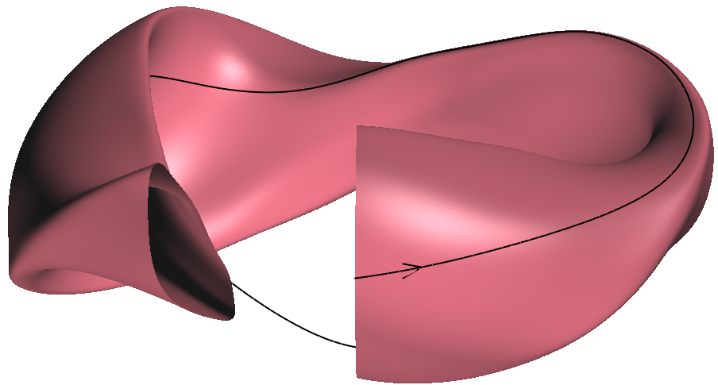
NCSX Linear Simulations

Slide 18
NCSX minus curvature

Slide 19
Eigenmode Structure for kρ ~ 1

Slide 20
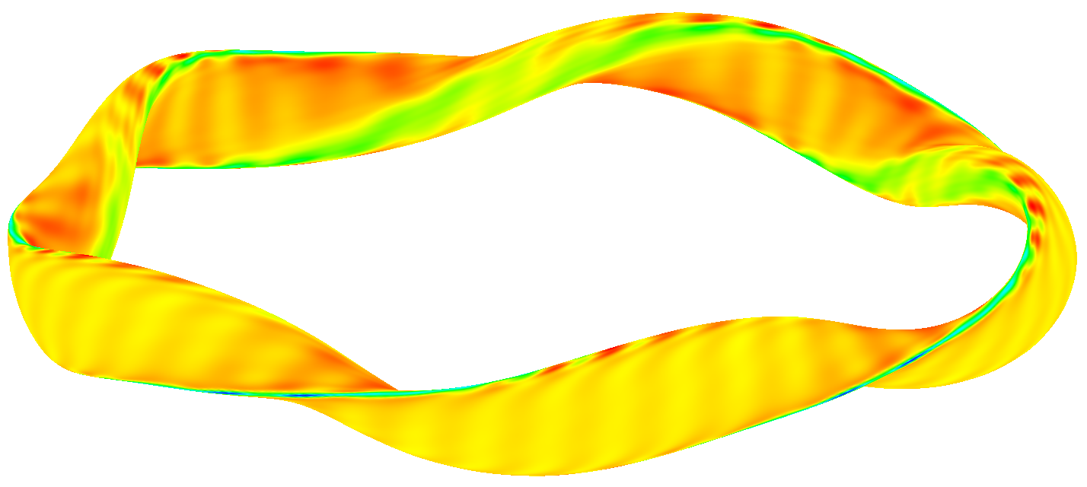
Linear Simulations using GENE W7-X (including curvature)
center of flux tube: on the helical ridge, at the “triangular plane”

Slide 21
Eigenmode Structure for kρ ~ 1 W7-X No Shear

Slide 22
Eigenmode Structure for kρ ~ 1 W7-X with Shear

Slide 23
How much does shear “boxing” actually matter?
(a/L_n = 1.0, a/L_T = 3.0)

Slide 24
Part II: “Bad curvature”
“Ballooning” = mode localization via global magnetic shear
“Boxing” = mode localization via sudden shear spike
Option 3: Curvature wells set the parallel extent (i.e. the usual rule-of-thumb k_{ıı} = 1/qR)

Slide 25
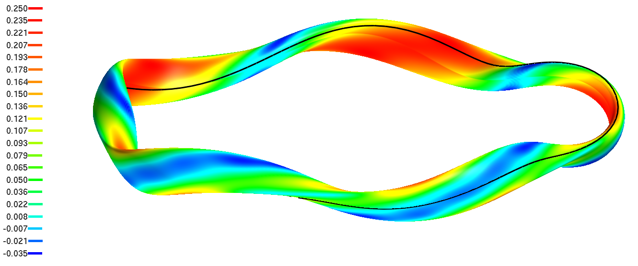
Curvature Landscape of W7X

Slide 26
“S-Alpha W7X”
No magnetic shear
a/R = 1/11 to mimic W7X
(un)safety factor q = 0.6 = (L/πR)_{W7X}
Periodic “Bloch wave” solutions

Slide 27
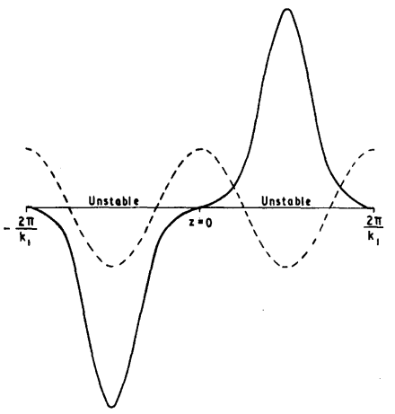
“S-Alpha W7X”
No magnetic shear
a/R = 1/11 to mimic W7X
(un)safety factor q = 0.6 = (L/πR)_{W7X}
Periodic “Bloch wave” solutions
Jukes, Rohlena, Phys. Fluids 11, 891 (1968)

Slide 28
Growth Rate Comparison
(a/Ln = 1.0, a/LT = 3.0)

Slide 29
Growth Rate Comparison
(a/Ln = 1.0, a/LT = 3.0)
“Boxing”

Slide 30
Growth Rate Comparison
(a/Ln = 1.0, a/LT = 3.0)
“Boxing”
“Bloching”

Slide 31
Growth Rate Comparison
(a/Ln = 1.0, a/LT = 3.0)
“Ballooning”

Slide 32
Part III: Nonlinear Theory (a preview)

Slide 33
Conclusion
Generally, magnetic geometry determines parallel variation of ITG turbulence in two ways – curvature and (local or global) magnetic shear
Theoretical model of shear “boxed” ITG mode demonstrates the potential for strong stabilization.
At large k, numerical simulations confirm significant stabilizing influence of local magnetic shear.
W7X ITG mode behaves as conventional curvature (“toroidal branch”) mode at low k, matching closely to a fictitious tokamak (s-alpha-W7X) ITG mode at the same parameter point.
Summary: Simple “boxed” models capture the ITG mode in a flux tube. The modes match expectations from Tokamak calculation at a similar parameter point.
Exotic stellarator geometry effects do not seem to strongly effect the ITG mode.
We can hope to understand the turbulence with existing theoretical machinery (+ epsilon)

