Slide 1
2.4m Space Telescopes
Hardware Summary
September 4, 2012
This document is not subject to the controls of the International Traffic in Arms Regulations (ITAR) or the Export Administration Regulations (EAR).

Slide 2
Hardware Summary
Available Flight Hardware
  Two, 2.4m, two-mirror telescopes
    One completed with full thermal hardware
    Electronics & Actuators have been harvested but can be rebuilt to existing drawings
  Two outer barrel assemblies
    One fully completed with thermal blankets and butterfly doors
  One hardware radiator/electronics bays
    Aluminum structures for radiator and electronic attachment
    Acted as a “spacer” between the spacecraft and the outer barrel assembly
All ground support equipment for alignment, integration, and test
Miscellaneous parts for a third system
Robust traceability has been retained for all flight hardware

Slide 3
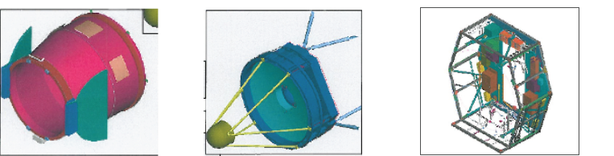
Hardware
Outer Barrel Assembly
(OBA)
2 Assemblies Available
Telescope
Subsystem
(TSS)
2 Assemblies Available
Payload Radiator Subsystem
(PLRSS)
1 Assembly
Available

Slide 4
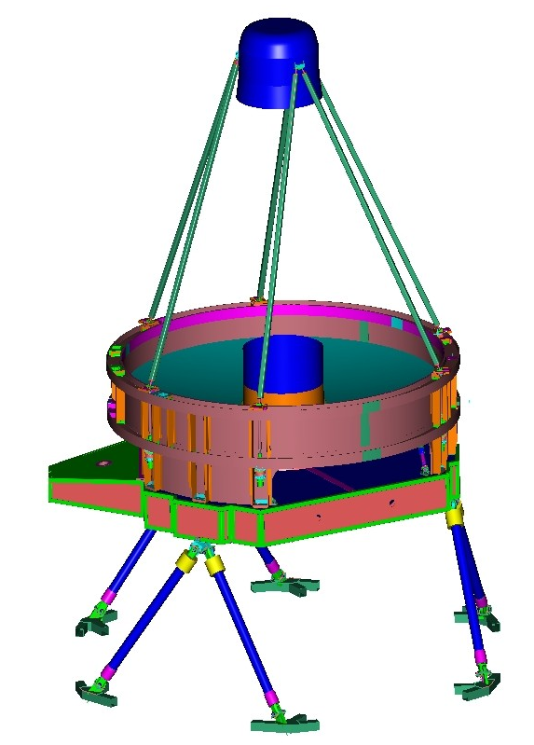
Forward Optics Assembly (FOA) Configuration
Secondary Mirror Support Structure
(SMSS) w/ Cover
Secondary Mirror Support Tubes
(SMST)
Primary Mirror
(PM)
Forward Metering Structure
(FMS)
Aft Metering Structure
(AMS)
Alignment Drive Tubes
(ADT)
Main Mounts
(MM)
Main Mount Corner Block
(MM CB)

Slide 5
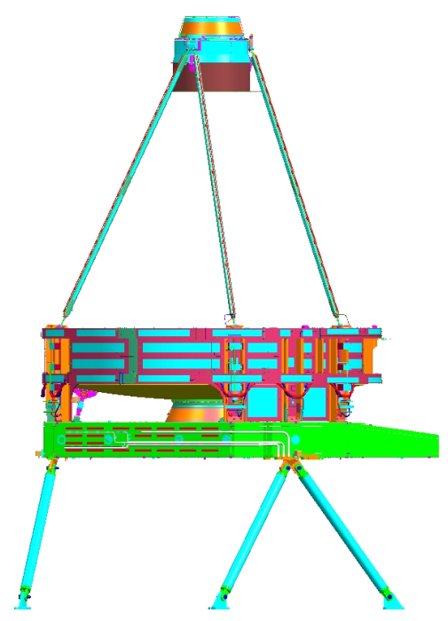
2.4m Space Telescope Form
Optical Form: 2 Mirror, f/8
Aperture: 2.37m
Unvignetted Field of View: ~ 1.8⁰ Dia.
Wavefront Quality: <60 nm rms
Secondary Mirror Assembly Control –
  6 DOF plus fine focus
  6 DOF Actuators are at the base of the secondary struts
  Focus actuator is behind the SMA
Mass: 840kg
Back Focus: 1.2m behind PM Vertex
  ~ 5.8 m³ Volume Available for Instruments, Sensors, Electronics

Slide 6
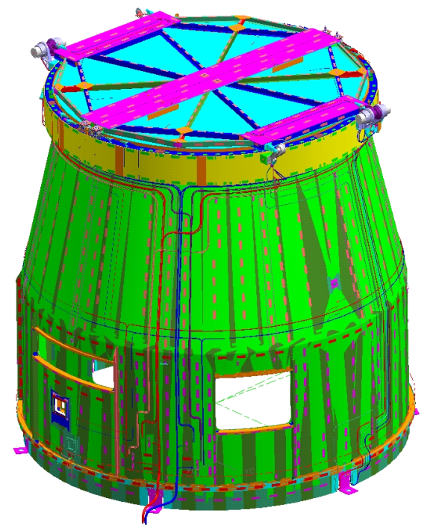
Outer Barrel Assembly
Thermal Protective Enclosure
including Two Actuated Thermal Butterfly Doors
Composite Structure
Full MLI blanket set also completed
Mass: 280kg (without blankets)
Mounting: Requires Interim Structure connected to Spacecraft Interface

Slide 7
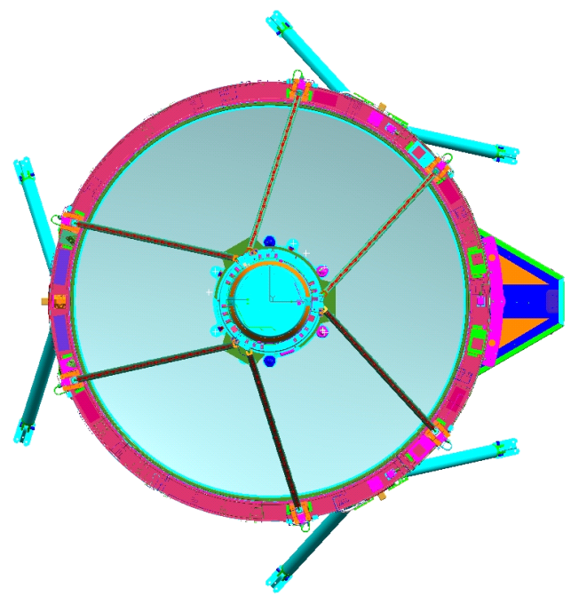
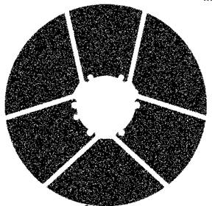
System Obstruction
Seven coating artifacts
correctable by recoating
On Axis Pupil
17% Obstructed
Strut Mean Width: 41mm
Strut Obstruction Length: 881mm

Slide 8
Mirror Quality and Coating
Primary Mirror (~40kg/m²)
Clear Aperture: 2.37m OD, 0.7m ID Form: Concave, F/1.2
Surface Quality: 12nm RMS Mirror Coating: Protected Silver
TDM Spec
1D psd (nm² cm)
0.01
0.1
Spatial Frequency f(1/cm)
2 Dimensional Average PSD
Secondary Mirror
Clear Aperture: 0.53m OD, 0.02m ID Form: Convex
Surface Quality: 16nm rms Mirror Coating: Protected Silver

Slide 9
Telescope Thermal Configuration
SMA
Cold biased design - Outer Barrel Assembly (OBA) serves as a passively cooled radiative enclosure to attenuate environment changes.
Heaters control telescope: Aft Metering Structure (AMS), Forward Metering Structure (FMS), Secondary Mirror Assembly (SMA), Secondary Mirror Support Tubes (SMST)
    Minimize radial and diametrical gradients near PMA
  Independent prime, redundant, and survival heaters
    Control telemetry for each heater zone
    Prime & redundant for computer-based control
    Autonomous hybrid heater controllers (HHC) for survival
  OBA heater control located on door mechanism only
MLI on FMS, SMA, OBA OD, SMST surfaces away from PM
SMST
FMS
AMS
Heater Zones by Region (Prime Side Only)
Heater Location | # of Zones | Capacity (Watts)
AMS | 24 | 102
FMS | 21 | 100
SMST | 12 | 106
SMA | 5 | 25

Slide 10
ITT Exelis State of the Art Material Technology
Utilized to Provide Stable Telescope
Hygro strain
< 15 µin/in
Invar Fittings where
required for stability
  CTE: < 0.4 µin/in°F
  Temporal Stability
  (Invar growth):
  < 2 ± 1 µin/in/yr
Hybrid Laminates with low CTE, low CME, and high modulus (patented)
  0 CTE (0.0 ± 0.1 µin/in°F) in all inplane directions
Cyanate Siloxane Resin with low moisture uptake (ITT/Hexcel development)
Neat Resin Equilibrium at 50%RH
2.5
Epoxy
% Moisture
Cyanate
Ester
0.5
0.22
Cyanate
Siloxane
t1
t1*14
Time

Slide 11
Thermal Operating Considerations
Telescope system was designed to operate around 293K (Room Temperature)
  Does not require requalification for warm launch
Various material considerations influence using the system at colder temperatures
  Mirror Materials
    Corning ULE™ is optimized for room temperature applications
    ULE™ has been tested at 20K with degraded CTE characteristics
  Structures
    Laminate also optimized for room temperature use
    CTE characteristics degrade slowly so some level of off-nominal conditions would be acceptable
  Bonding Materials
    GE RTV-566 used to attach mirrors to mounts would need qualification at off-nominal temperatures
  Mechanisms
    Precision mechanisms would be a concern
Low Risk
Minor Mat’l Testing
Minor Risk
Refigure Mirrors/Qual Composites
& Adhesives/
Modify some mechanisms
Major Rework
Major redesign of system
  300 275 250 225 200 150 →
Operating Temperature (K)

Slide 12
Summary
Telescope system designed for room temperature operation
  Off optimal thermal configuration is possible with some level of analysis and retest
  We do not recommend operating temperatures below 200K due to numerous material, electronic, and optical considerations
Some minor rework on the telescope is very low risk
  Telescopes were designed to be taken apart and refurbished
  Ion figuring and recoating would be considered very low risk for example
Instrument section is the most doubtful of the configuration
  Aluminum and heavy
  Designed for a specific instrument accommodation
  Not a cost driver to replace with a better form factor
Outer Barrel Assembly is probably shorter than desired for NASA mission
  Extension and repositioning is low cost and low risk
Point of Contact
  Dr. Jennifer Dooley – JPL Jennifer.A.Dooley@jpl.nasa.gov

